Slide 1


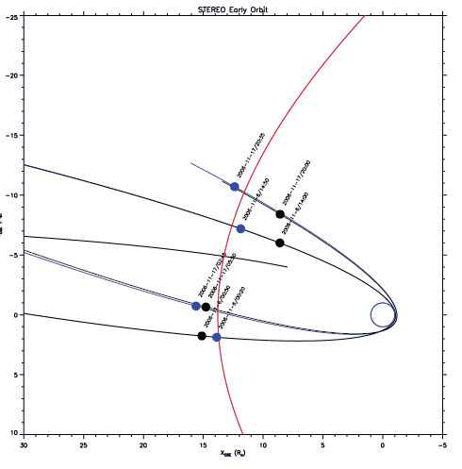
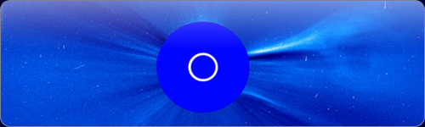
The Physics of the plasma sheath

Slide 2
The Physics of the plasma sheath
The space is filled with space plasma.
The plasma interacts with an object made of conducting material (spacecraft) which is immersed in the plasma.
A boundary zone forms around the body.
This boundary zone is called plasma sheath.
Basics

Slide 3
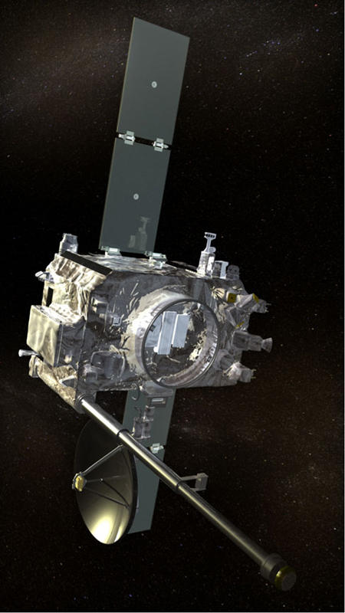
The Physics of the plasma sheath
2 or 3 different currents flow to the spacecraft, depending on the environment.
In a steady state condition the, sum of the currents must be zero.
Depending on the magnitude of the photo-electron current, the spacecraft can be charged positively or negatively.
Depending on the charging, there are two different forms of the sheath possible.
Basics
+
-
-
Ion current
Photoelectron
current
Electron
current

Slide 4

The Physics of the plasma sheath
If there's no illumination, just thermal electrons and ions are present.
A thermal electron current and a thermal ion current exists.
If ions and electrons are in thermal equilibrium, the mean speed of the electrons will be higher:
--> more electrons hit the surface in a given time interval.
--> the S/C will be charged negatively.
--> the negative charge of the S/C pushes away the mobile electrons.
--> the heavy ions are attracted.
--> an electron depletion zone forms around the S/C
--> the sheath thickness and S/C potential will adjust such that the currents have the same magnitude
Negatively charged spacecraft

Slide 5



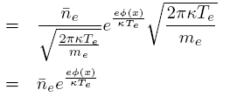



The Physics of the plasma sheath
Postulation: the thermal electrons are Maxwell distributed in phase space.
The energy is conserved.
Particle density: Zeroth moment
Drift velocity: first moment x charge.
V is the potential of the S/C (V<0)
The electron current

Slide 6





The Physics of the plasma sheath
All ions reach the surface.
They fall into a potential well.
--> accelerated.
--> density decreases due to mass conservation.
The energy is also conserved.
Combining both conservation laws yields a formula for the particle density.
From both expressions, an equation for the current can be found.
Using the particle flux conservation, the final equation can be formed.
The ion current

Slide 7

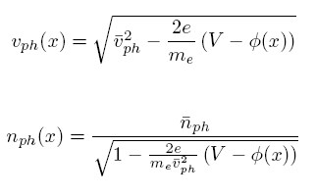
The Physics of the plasma sheath
Photoelectrons are created due to photons impacting the surface (often solar origin).
All photoelectrons reach the plasma.
The current at the surface depends on flux and energy distribution of the photons, on the material and the geometry of the illumination.
i_{ph} ...current density at the surface.
A_{Φ}...illuminated area cross section.
Speed and density can be computed as for the ions.
The photo-electron current

Slide 8



The Physics of the plasma sheath
Defining the potential in a way to fulfill the boundary condition
To calculate the potential of the spacecraft, the sum of all currents can be set to zero (steady state condition).
Quasi-neutrality was postulated.
An expression can be found with or without the influence of the ions.
The influence of the ions is small.
The potential of the S/C
A_{rel}...fraction of surface area which is illuminated.

Slide 9


The Physics of the plasma sheath
To compute the potential distribution, Poisson's equation has to be solved.
The curve must be convex.
Non-linear --> has to be solved numerically.
This is the approximation for a flat surface.
The potential distribution

Slide 10
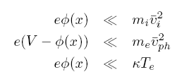
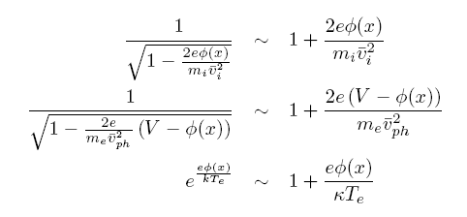

The Physics of the plasma sheath
If the potential energy is small in relation to the thermal and kinetic energies, a Taylor expansion can be used.
This corresponds to the boundary area.
Linearization

Slide 11

The Physics of the plasma sheath
To preserve the physical content of the original equation, the curve must remain convex.
So the term in the brackets on the left side must be smaller than zero. (negative potential)
Neglecting the photoelectrons, this results in the Bohm criterion.
Bohm criterion

Slide 12





The Physics of the plasma sheath
assuming quasi-neutrality
Without photo-electrons
The solution, including the boundary conditions:
λ_{sh} is the distance where the potential decreases by a factor of e:
Due to the Bohm criterion it is of the same order of magnitude as the Debye length.
can be used as first approximation.

Slide 13
The Physics of the plasma sheath
The number of photo-electrons exceeds the number of thermal electrons.
In a steady state condition the sum of the currents must be zero.
-->The body builds a positive charge such that the number of photoelectrons reaching the plasma is roughly equal to the number of thermal electrons impacting on the surface.
All other photo-electrons are not able to cross the potential difference and fall back to the surface.
These photoelectrons form an electron sheath.
They do not contribute to the photo-electron current.
Positively charged spacecraft

Slide 14




The Physics of the plasma sheath
All thermal electrons reach the surface --> no Boltzmann factor required.
Only the photoelectrons with enough energy reach the plasma.
The photoelectrons are roughly Maxwell distributed.
The current of the back falling photo-electrons:
In a steady state condition the photo-electrons escaping are replaced by thermal electrons.
-->The total electron current reaching the surface :
The currents

Slide 15

The Physics of the plasma sheath
The potential of the spacecraft can be deduced by equating thermal and photo-electron current.
The spacecraft potential

Slide 16


The Physics of the plasma sheath
The photo-electron density at the surface can be found by using .
Since the escaping photo-electrons are replaced by thermal electrons, the total electron density must be roughly twice the outgoing photo-electron density, ignoring the charge contribution of the ions.
The densities

Slide 17


The Physics of the plasma sheath
The distribution of the photo-electron density.
The factor 2 is to include the photo-electrons which are falling back.
The density of the thermal electrons can be derived as before.
The heavy ions are assumed not to be influenced by the potential gradient.
The densities

Slide 18


The Physics of the plasma sheath
Flat surface approximation.
Substitution of the densities.
The governing differential equation

Slide 19
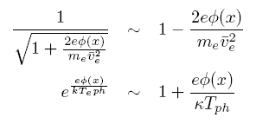


The Physics of the plasma sheath
Taylor expansion.
Assuming quasi-neutrality.
The solution is the sum of an exponential function and a constant.
Does not fulfill the boundary conditions.
One can define the shielding length.
The linearized equation

Slide 20


The Physics of the plasma sheath
For a cylindrical antenna the solution of the Poisson's equation in cylindrical polar coordinates is interesting.
The equation can be brought in the form of a Sturm-Liouville problem.
The solution is a modified Bessel's equation.
Details are not yet worked out.
To do

Slide 21
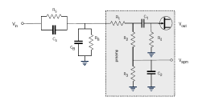
The Physics of the plasma sheath
Spacecraft antennas are usually coupled to the surrounding space plasma.
The electromagnetic coupling can be modeled by a system of a resistance and a capacitance.
In rarefied plasma the coupling can not take place without photoelectrons.
The sheath thickness must not be larger than the antennas.
Spacecraft antennas

Slide 22



The Physics of the plasma sheath
The sheath resistance is the gradient of the V-I curve.
Explicit expression for negatively charged S/C after [Gurnett 2000]
The resistance can be neglected at high frequencies.
For the capacitance the general equation for cylindrically shaped capacitors can be used.
Negatively charged spacecraft

Slide 23


The Physics of the plasma sheath
The expressions for the positively charged spacecraft.
ε_{r} is the relative impedance tensor which depends on the model used.
Changes continuously along the sheath.
As a first approximation the mean value could be used.
Positively charged spacecraft

Slide 24


The Physics of the plasma sheath
STEREO operates in solar wind conditions at 1AU.
The photo-electron production rate is higher than the thermal electron impact rate. --> positive charge.
i_{ph}...10⁻⁴Am⁻²
A_{rel}...0.5
l=6m
d=1in (0.0254m) on average
Mean energy of photo-electrons=1.5eV
Mean energy of thermal electrons=10eV
Application
-->V=5.5V
n_{e}=10⁶m⁻³
-->n_{ph}(0)=2x10⁸m⁻³
-->2.5% of the photo-electrons reach the plasma.
-->λ_{sh} =85cm, using the photo-electron Debye length at the surface.

Slide 25
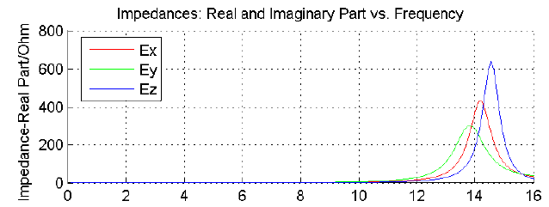

The Physics of the plasma sheath
Using the appropriate equations, one finds:
  R_{s}=0.2MΩ
  C_{s}=87pF
Via these parameters the sheath can be included into the numerical antenna calibration (wire-grid).
No calculations for the effective length vectors where done so far.
Computation of the impedances show that the inclusion of the sheath has an effect.
Application

Slide 26
The Physics of the plasma sheath
Stuart Bale estimates
  R_{s}=0.75MΩ
  C_{s}=40pF
The figures show the impedances using Bale's values in relation to the results using our theoretical model.
Application

Slide 27

The Physics of the plasma sheath
Comparing the location of the second resonance of antenna E_{z} with measured data shows that the inclusion of the sheath capacitance has a corrective effect.
Further and more accurate data is needed to verify the model.
Application

Slide 28
The Physics of the plasma sheath
The surface of a body immersed in space plasma interacts in a complicated way with the plasma.
The body is charged negatively or positively and a sheath is formed.
Models approximating the physics of the sheaths were derived.
An exact solution of the potential/density is not possible by analytical means.
Solutions for the linearized models describing the sheath of a flat surface, were presented. They are not valid across the whole sheath and therefor do not fulfill the boundary conditions.
Solutions for the cylindrical surface can be found but were not presented.
Representing the sheath by a combination of resistivity and capacitance, the coupling of the antenna to the space plasma can be included into the numerical antenna calibration.
Final Remarks

Slide 29
The Physics of the plasma sheath
As an example, the STEREO mission was used.
The effect on the computed impedances was shown and compared to Stuart Bales estimation.
Further calculations regarding the effect on the effective length vectors have to be performed.
Further, more accurate data is needed for verification.
The other antennas have resonance peaks within the frequency of the receiver and are therefor more suited.
Many estimations have to be used in the model.
A uniform sheath around the spacecraft has been assumed. This is not realistic, because the photoelectric effect takes only place at the side directed towards the sun.
The velocity of the spacecraft has been neglected.
The model for the density of the photoelectrons has to be rethought.
Final Remarks

